Slide 1

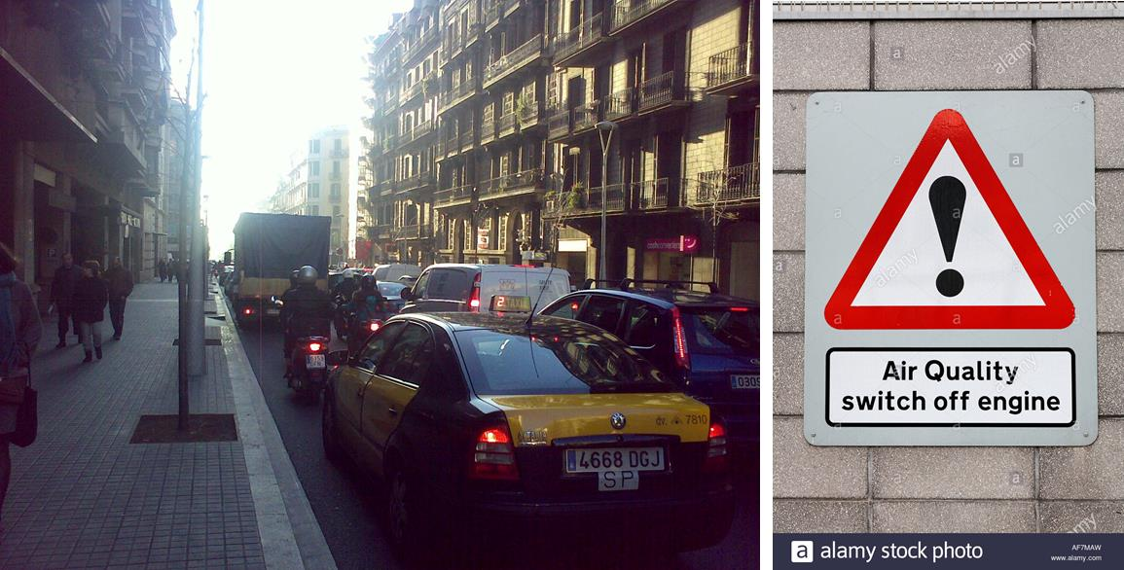
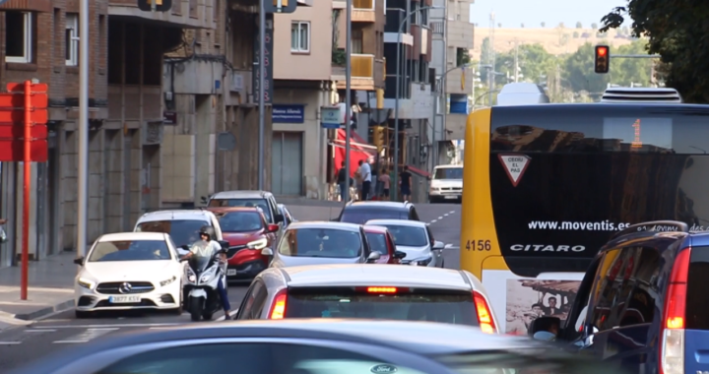


Qualitat de l’aire i mobilitat urbana
Xavier Querol Carceller
Institut de Diagnosi Ambiental i Estudis de l’Aigua (IDAEA) - CSIC

Slide 2
Qualitat de l’aire
Valors guia OMS(2005 & 2006)
2008/50/EC & 2004/107/EC WHO (2006) guidelines
RD 102/2011
Hourly 350* µg/m³ SO₂ 500 µg/m³ SO₂ *24 hours/year
Daily 125* µg/m³ SO₂ 20 µg/m³ SO₂ *3 days/year
Hourly 200 µg/m³ NO₂ EC-WHO coincide 18 hours/year
Annual 40 µg/m³ NO₂ EC-WHO coincide not exceeding
Annual 5 µg/m³ C₆H₆ EC-WHO coincide not exceeding
Mean 8-h max. in a day 10 mg/m³ CO EC-WHO coincide not exceeding
Annual 500 ng/m³ Pb EC-WHO coincide not exceeding
Annual 40 µg/m³ PM10 20 µg/m³ PM10 not exceeding
Annual 25 µg/m³ PM2.5 10 µg/m³ PM2.5 not exceeding
Daily 50* µg/m³ PM10 50** µg/m³ PM10 3** or 35* days/year
Max 8 h means of a day 120 µg/m³ O₃ 100 µg/m³ O₃ 25 days/year
mean for 3 years
Annual 1 ng/m³ BaP 0.12 ng/m³ BaP not exceeding
Actualment en revisió a la baixa

Slide 3
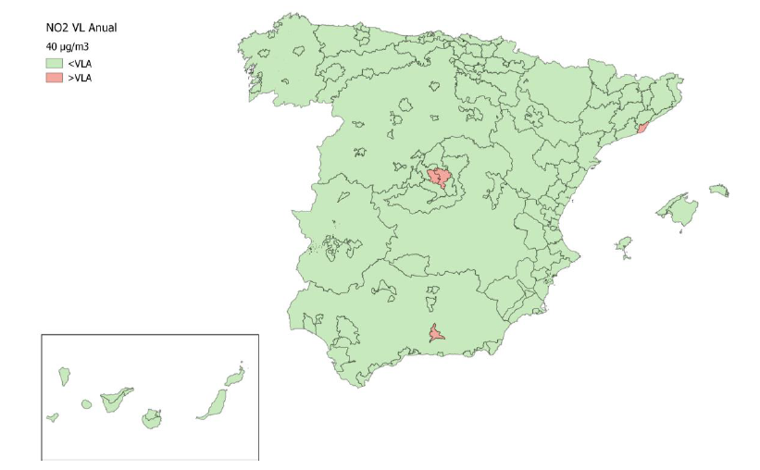
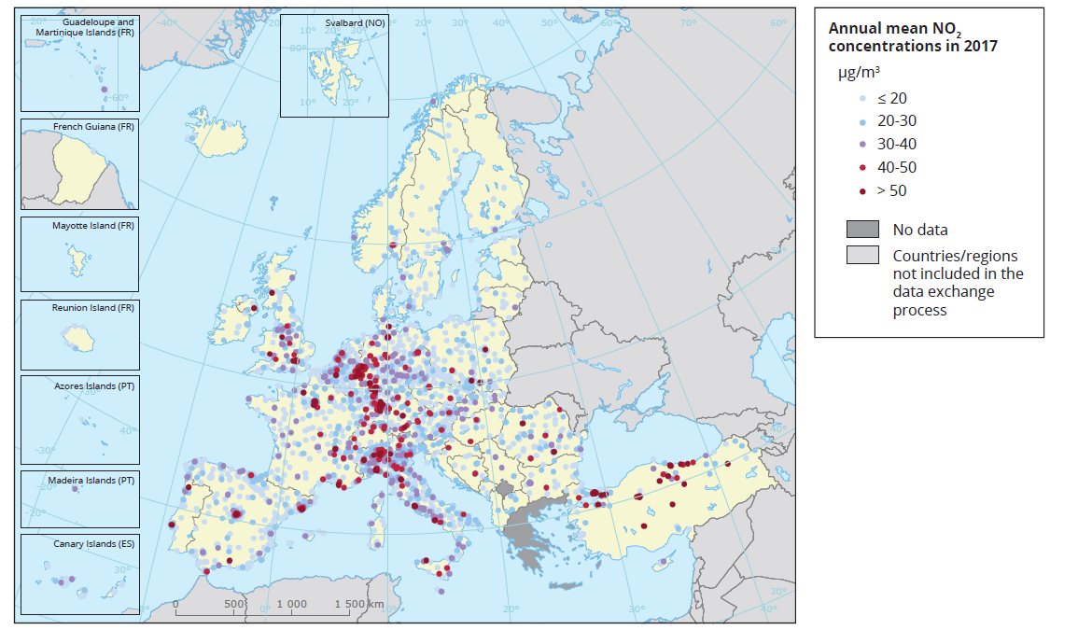

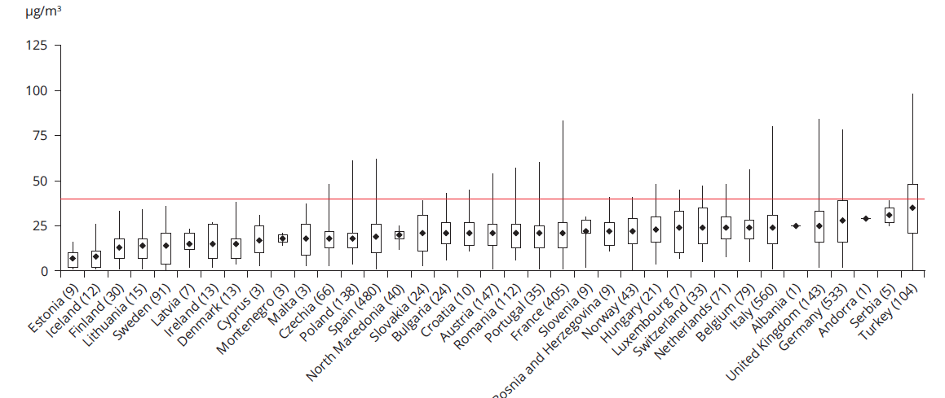


El problema del NO₂
NO₂ anual 2017
2018
Madrid
Barcelona
Granada
WHO
16/10/2019

Slide 4
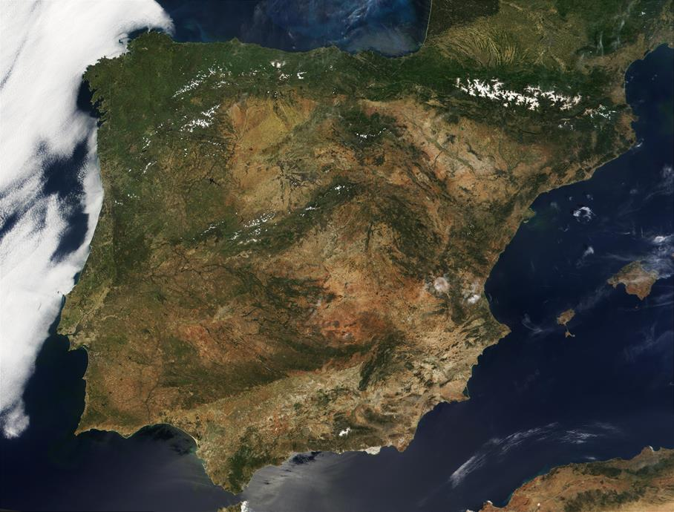
El problema del NO₂
% Reducció/increment de NO₂ durant el confinament COVID19,
amb la correcció de 2015-2019
%NO₂
-42
-27
-28
-33
-40
-33
-47
-48
-54
-48
-55
-43
-62
-45
LOCKDOWN
-44
-35
RELAXATION
-36
-20
-54
-49
-47
-16
METROPOLITAN AREAS

Slide 5
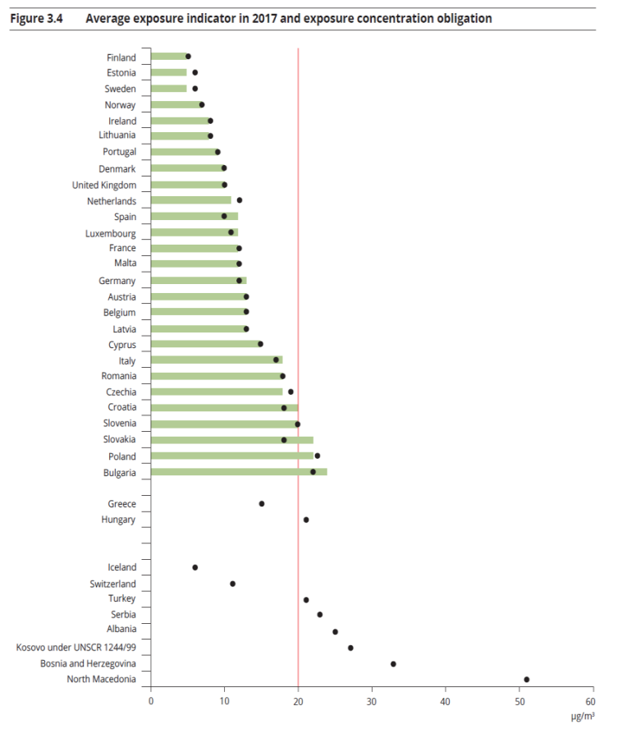
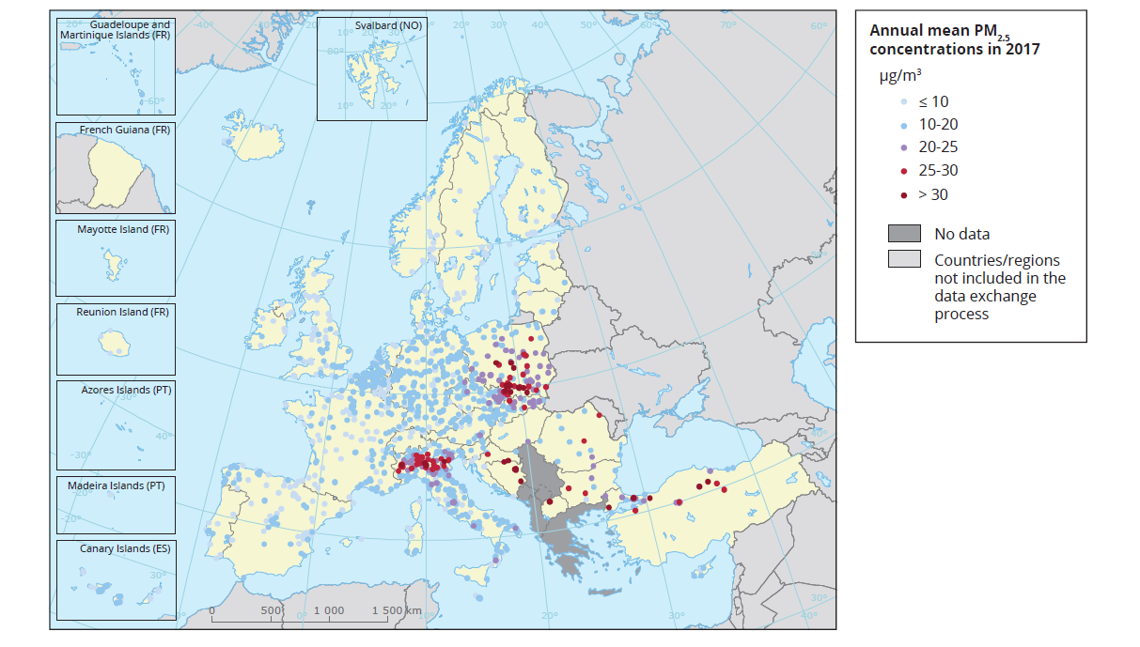
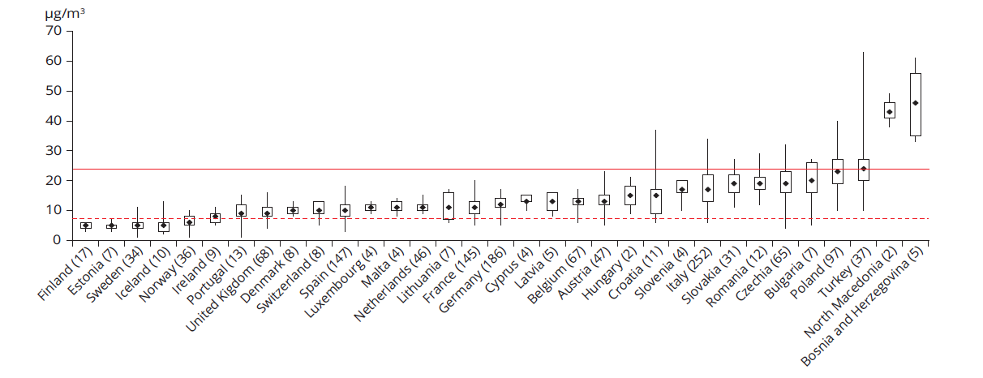
El problema del PM
PM2.5 VL anual 2017
PM2.5 2017
PM2.5 anual 2017
EU-ALV
WHO
16/10/2019

Slide 6

El problema del PM
PM10 (annual mean)
PM10 (days of exceedance)
1. Road Traffic is the main source contributing to PM10: 31-38% (ATH 23%)
1.1. Vehicle exhaust + traffic related NO₃⁻ are the main causes: 21-29% (ATH 15%)
1.2. Non-exhaust vehicle emissions are also relevant: 8-11%
2. Regional OC and/or SO₄²⁻ dominated pollution: 20-26% (POR-TR 10%)
3. Local dust : 10-19%
4. Biomass burning very relevant in POR & FI (14-16%), less in ATH (7%) and negligible in BCN
5. Industry BCN 11%, 4-5%, ATH <1%
6. Non traffic-NO₃⁻ 6-8% (2% POR)
7. Shipping 4% in coastal sites
8. African dust ATH 14%, 1-4%
9. Sea salt POR 13%, 4-8%
10. Anthropogenic dust (Local dust + Non exhaust) reaches 19-25%
36-45% (ATH 15%)
30-34% (ATH 6%)
18-29% (ATH 3%, POR 6%)
BCN 19%, 2-6%
POR 27%, 1-4%
POR & FI (25-30%), ATH 1%, negligible in BCN
BCN 17%, <1-3%
BCN & FI 7-9% (1-2% POR & ATH)
3-4% in coastal sites
ATH 52%, 1%
ATH 7%, 1-3%
11-33%, ATH 4%
PM2.5 (annual mean)
PM2.5 (days of PM10 exceedance)
1. Road Traffic is the main source contributing to PM2.5: 28-39% (ATH 22%)
1.1. Vehicle exhaust + traffic related NO₃⁻ are the main causes: 25-34% (ATH 17%)
1.2. Non-exhaust vehicle emissions are also relevant: 5-9% (BCN&FI 1-2% )
2. Regional OC and/or SO₄²⁻ dominated pollution: 19-37% (POR 13%)
3. Local dust: POR 16%, 2-6%
4. Biomass burning very relevant in MLN, FI & POR (18-21%), less in ATH (10%) and negligible in BCN
5. Industry 5-12%, ATH <1%
6. Non traffic-NO₃⁻ 3-6% (POR 1%)
7. Shipping 5-7% in coastal sites
8. African dust: ATH 6%, <1%
9. Sea salt POR 5%, <1-3%,
10. Anthropogenic dust (Local dust + Non exhaust) reaches 10-21%, BCN 7%, FI 4%
32-42% (ATH 11%)
31-40% (ATH 10%)
1-7%
BCN & MLN 11-22%, 2-6%
POR 22%, 1-2%
POR, FI & MLN (26-33%), <2%
BCN 18%, <1-3%
BCN, FI & MLN 6-9% (1-3% POR & ATH)
6-10% in coastal sites
ATH 45%, 1%
<1%-1%
POR 15, 3-9%

Slide 7

Mesures sobre el trànsit per millorar qualitat de l’aire
0. Air quality plans should be devised at the scale of the metropolitan area
ii. Measures to reduce number of urban vehicles circulating
iii. Measures favoring renewal and transformation of urban vehicle fleets
(LEZ, CAs, taxes,..)
iv. Urban distribution of goods (urban freight distribution) & taxis
v. Urban re-design: priority pedestrians and green areas
vi
vii
vi. Remediation measures
vii. Other non-technological measures
i. Improving metropolitan public transport with links to park & rides connecting cities and bus lines

Slide 8

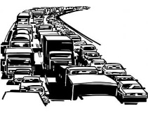
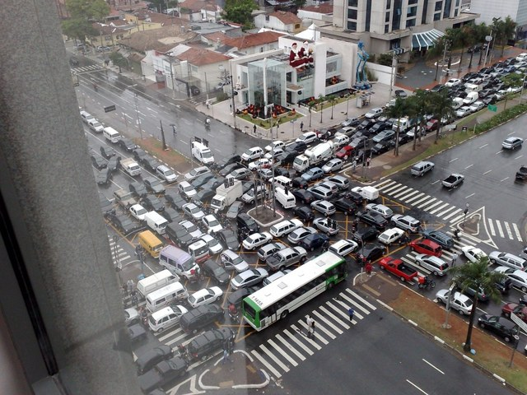
Mesures sobre el trànsit per millorar qualitat de l’aire
2. Measures to reduce the circulating urban vehicles

Slide 9
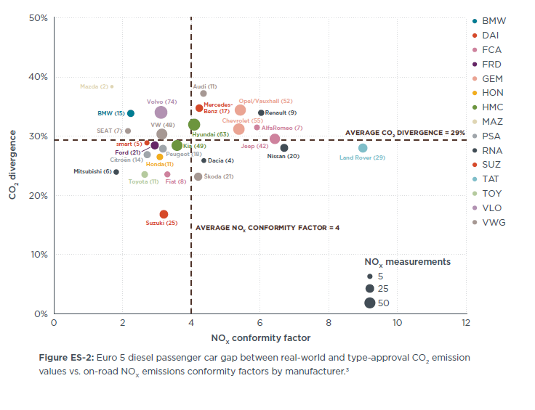
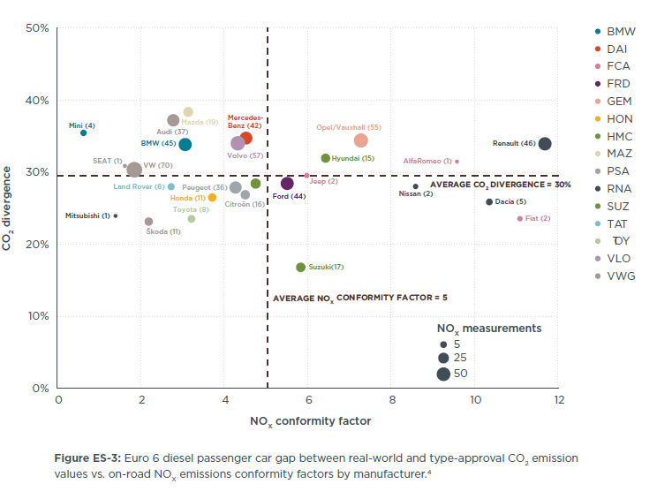

Mesures sobre el trànsit per millorar qualitat de l’aire
2. Measures to reduce the circulating urban vehicles
June 2017

Slide 10


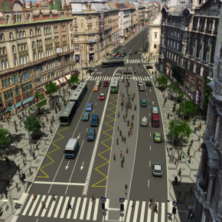
Mesures sobre el trànsit per millorar qualitat de l’aire
2. Measures to reduce the circulating urban vehicles
1.1. Public transport
1.2. Congestion charges
1.3. Parking restrictions

Slide 11
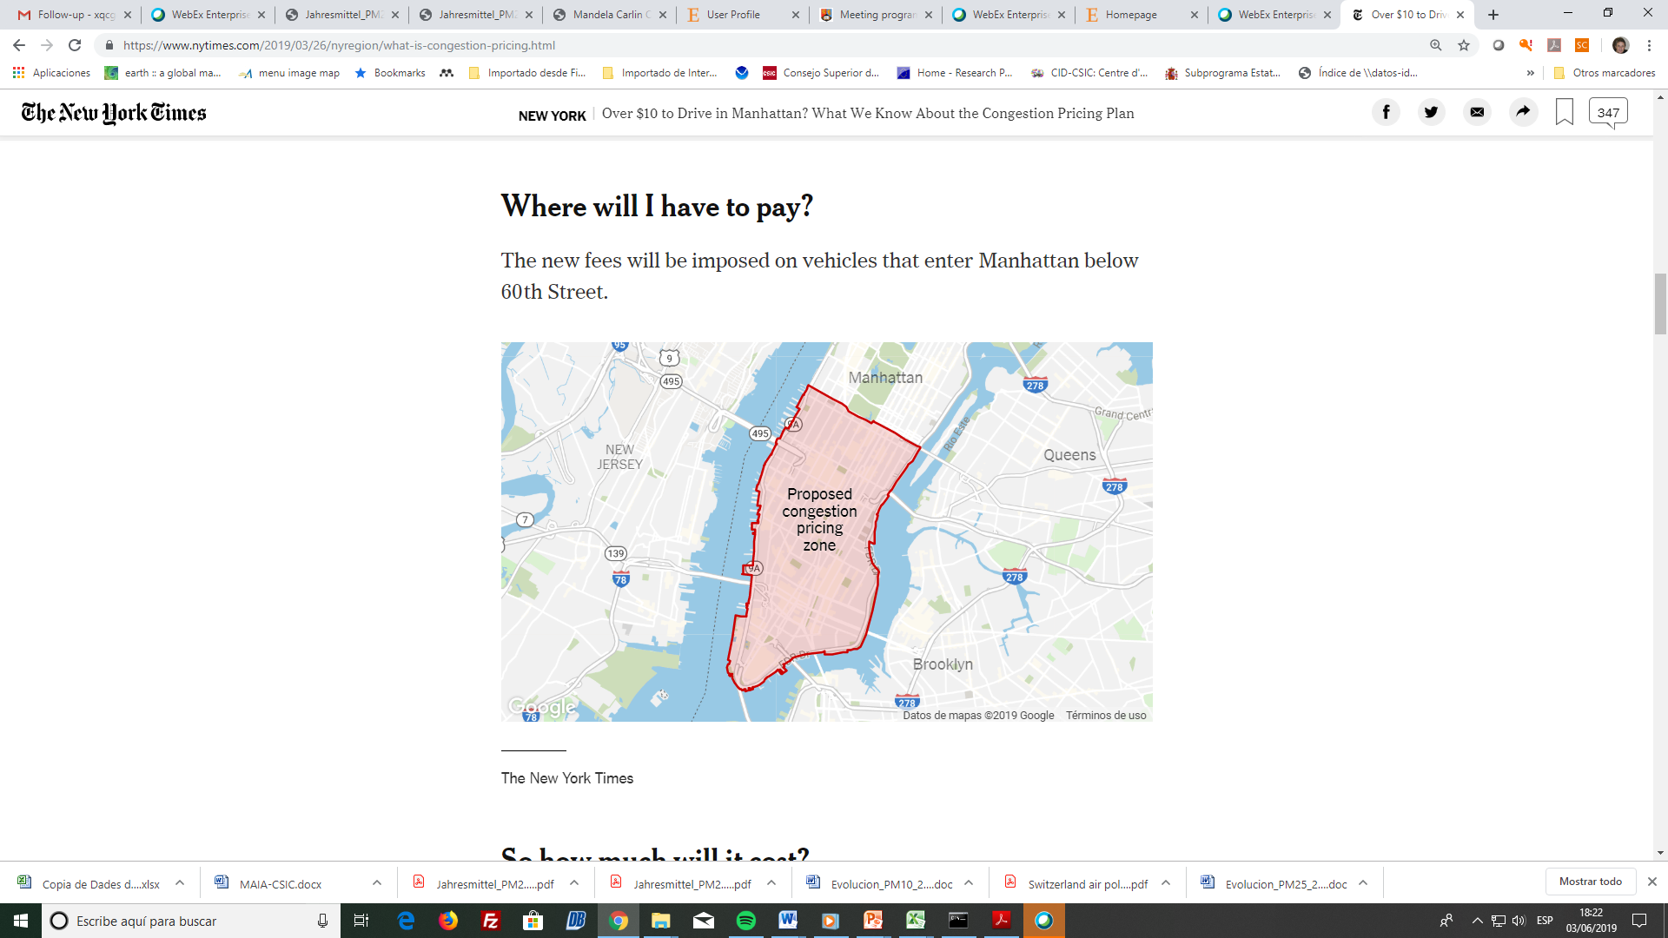
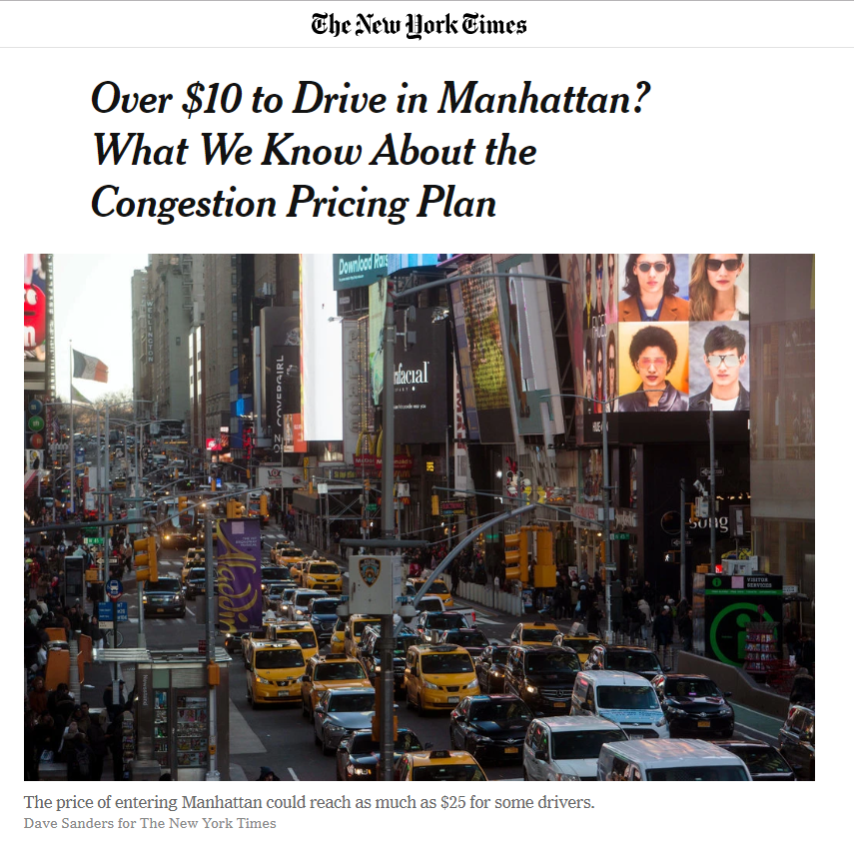
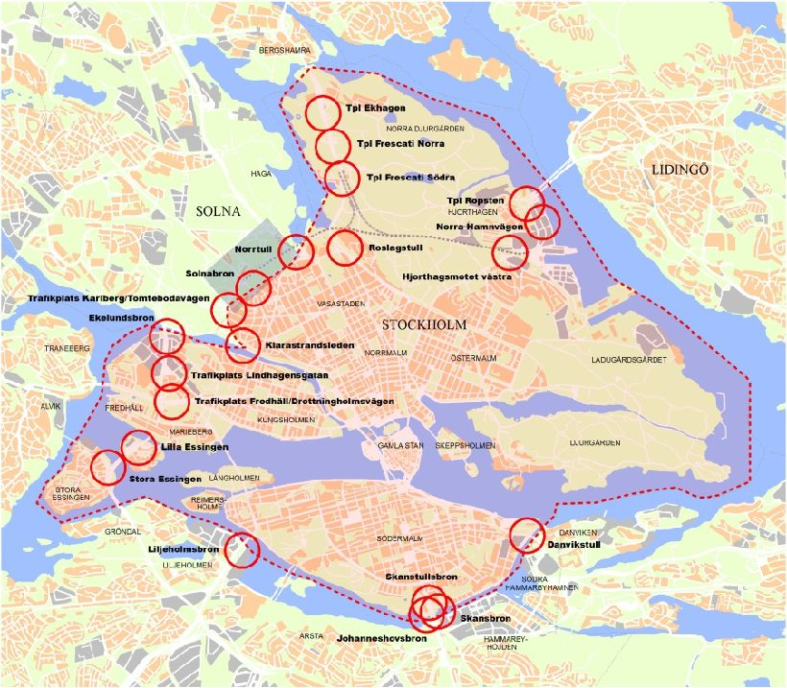
Mesures sobre el trànsit per millorar qualitat de l’aire
2. Measures to reduce the circulating urban vehicles
The Stockholm congestion tax
1 to 3.5 Euro for every passage
Max 11 Euro per day
Also foreign vehicles pay
Polpulation of Stockholm connurbation increased 200-2019 402000
>30 stations with APNR
Courtesy of Christer Johansson, 13/02/2020

Slide 12
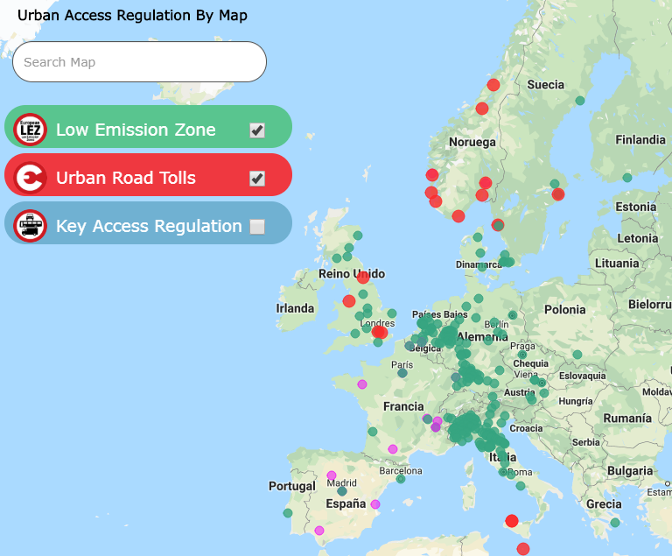
Mesures sobre el trànsit per millorar qualitat de l’aire
3. Measures to change fleets
Hollman C. et al., 2014 Atmos Environ: Effectivenss of LEZs in EU
LOW EMISSION ZONES
16 MEMBER STATES, 280 CITIES:
DE, NL, UK, NO, SE, DK, CZ, AT, HU, IT , ES
Must apply to ALL vehicle types
Strict in application
Also motor pets and motorbikes
Use real world driving criteria
AT (3)
Autopistes Tirol
CZ (1)
Praga
DE (50)
Augsburg, Berlín, Bochum, Bonn, Bottrop, Bremen, Dinslaken, Dortmund, Duisburg, Düsseldorf, Essen, Frankfurt, Friburg, Gelsenkirchen, Halle (Saale), Hannover, Heidelberg, Heilbronn, Herrenberg, Ilsfeld, Karlsruhe, Köln (Colonia), Krefeld, Leipzig, Leonberg, Leonberg, Ludwigsburg, Magdeburg, Mannheim, Markgröningen, Mühlacker, Mühlheim, München, Münster, Neu-Ulm, Neuss, Oberhausen, Osnabrück, Pfinztal, Pforzheim, Pleidelsheim, Pleidelsheim, Recklinghausen, Ratisbona, Reutlingen, Schwäbisch-Gmünd, Stuttgart, Tübingen, Ulm, Wuppertal
DK (5)
Aalborg, Aarhus, Frederiksberg, Copenhague, Odense
ES(2)
Madrid Central, Zona Baixes Emissions Barcelona
GB (3)
Londres, Oxford, Norwich
IT (42)
Roma, Milán, Livorno, Pisa, Módena, Nápoles, Palermo, Parma, Pavía, Pisa, Regggio Emilia, Rimini, Torino, Trento, Varese, Verona, Lodi, Lucca, Montove, Mezzocorona, Mondovi, Nichelino, Novara, Novi Ligure, Orbassano, Perugia, Piacenza, Prato, Ravenna......................
NL (13)
Ámsterdam, Breda, Delft, La Haya, Eindhoven, Leiden, Maastrich, Rijswijk, Rotterdam, Hertogenbosch, Schiedam, Tiburg, Utrech
NO (3)
Oslo, Bergen, Trondheim,
SE (6)
Estocolmo, Gotemburgo, Helsinburg, Lund, Malmo, Molndal
FR
Paris: Testing in 2012
http://es.urbanaccessregulations.eu/
ULEZ: April 2019: London will ban access diesel older than 09/2015 & gasoline older than 2005
CLEAN AIR ZONES (CAZS) IN UK
MADRID: Permanent LEZ Madrid Central, but only 4.2 km²
(LEZ+ non-residents access only if solo Zero & Eco vehicles, motorcycles LEZ, from 22 h only ECO mototcycles)
BARCELONA METROPOLITAN AREA: LEZ, 01/01/2020

Slide 13
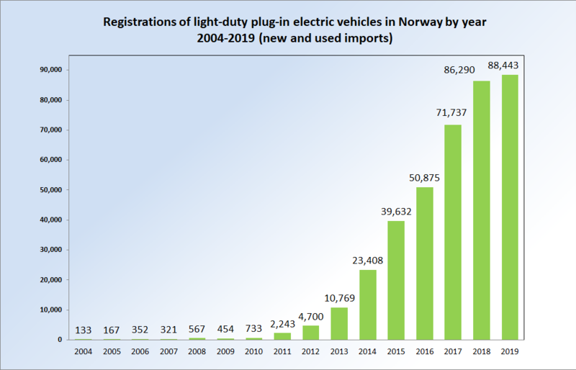
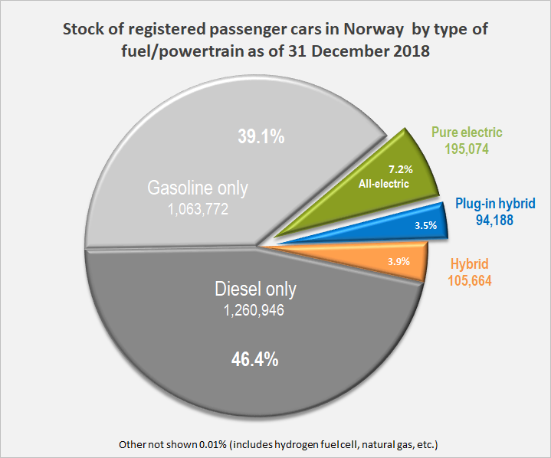
Mesures sobre el trànsit per millorar qualitat de l’aire
3. Measures to change fleets
e-vehicles
e-vehicles
Long term fiscal incentives from 1990s
Incentives added sequentially until the market responded
The price difference between battery EV and petrol car can be €1,000
  Exempt from
    vehicle registration tax
    road tolls
    VAT (normally 25%)
  Bus lane access
  BEVs -reduced annual tax
  Reduced rates on the main coastal ferries
56% of market share in 2019
0.8% Spain
Norway 13% e-vehicles in 2019
Urban freight distrobution & taxis with more km/day
Urban motorbikes
Norwegian Road Federation (OFV) (2019, 2018, 2017, 2016, 2015, 2014) Bilsalget i 2018, 2017, 2016, 2015, 2014, 2013. " [Car sales in 2018, , 2017, 2016, 2015, 2014, 2013] (in Norwegian). OFV. Retrieved 2019-01-03. https://ofv.no/
Norwegian Road Federation (OFV) (2019, 2018, 2017, 2016, 2015, 2014) Bilsalget i 2018, 2017, 2016, 2015, 2014, 2013. " [Car sales in 2018, , 2017, 2016, 2015, 2014, 2013] (in Norwegian). OFV. Retrieved 2019-01-03. https://ofv.no/
Notes:
Figure for EVs and plug in hybrids (PHEVs)
Included because Norway has the highest EV market share in Europe, but Netherlands also has the highest market share of PHEVS in the world
See comments earlier wrt to Dutch anti-diesel policies earlier

Slide 14
Mesures sobre el trànsit per millorar qualitat de l’aire
4. Urban freight distribution
Preferential electrification & hybridation, 1 vehicle UFD = 12 private cars due to kmtrage
Restrictions from 7 to 11 am (unfavorable meteo & traffic density)
Intelligent logistics (nocturnal, micro-platforms ......)
Strict regulations AND INFORCEMENT of minimum volume available for storing goods
Avoiding circulation of free taxis
......................

Slide 15
Mesures sobre el trànsit per millorar qualitat de l’aire
5. Urban (re-)planning
Example: Barcelona’s Superblocks
INCREASE DISTANCE CITIZEN-ROAD TRAFFIC, SPECIALLY MOST VULNERABLES
GREENING & GETTING MORE SPACE FOR CITIZENS
PROMOTION OF ACTIVE TRANSPORT (PEDESTRIAN & BIKE) FOR A HEALTHIER CITY

Slide 16

Agraïments
Gràcies per la seva atenció!
xavier.querol@idaea.csic.es
http://airuse.eu, http://cleanaircities.net, https://www.idaea.csic.es/egar/
xavier.querol@idaea.csic.es

